Slide 1
CS2105 Introduction to Computer Networks

Slide 2
About me
Clinton Law
Year 3 CS
Took this module last year
TA’d it last semester
Contact Details
Email me at clintonlaw@u.nus.edu
PLEASE include “CS2105” in the subject of your email!
Telegram handle: @clawyq
Collate any quick questions you might have (please don’t spam me)
With regards to assignments, to be fair to the rest I will only provide guidelines for understanding and approaching the problem

Slide 3
What you can expect
Tutorial flow
Quick recap of the content covered in the lectures
Iron out any question marks
Going through the tutorial questions
Grading
Participation
Questions I ask will be in round – robin style
Feel free to add any interesting points for discussion at any juncture

Slide 4
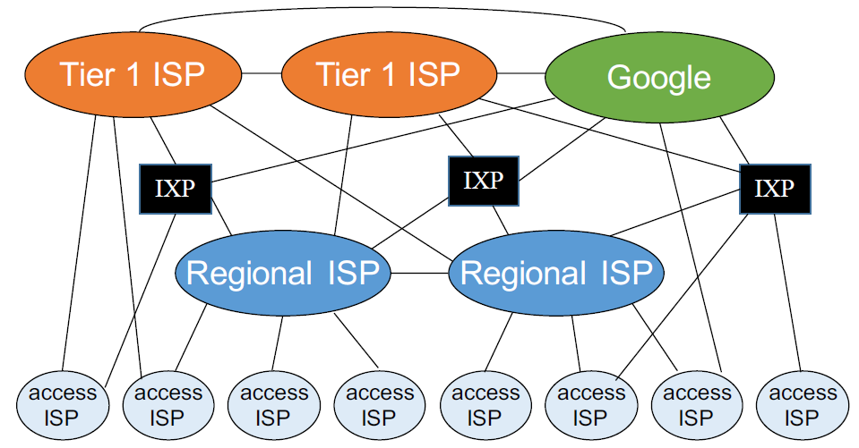
Recap
The Internet (structural breakdown)
network of networks
organised into autonomous systems(ASes) each owned by an organisation
Autonomous systems (owned by major corporations) -> regional ISPs -> access ISPs -> host end users (you!)
Notes:
2, 3

Slide 5
Recap
Applications communicate using protocols, which specify the message…
Format
Order
Actions to take upon receiving or sending a message
Basically contracts containing the blueprints that dictate cross network interactions e.g. HTTP, FTP, SMTP, TCP, RTP
Notes:
2, 3

Slide 6


Recap
Notes:
Layering
Modular
Separation of concerns

Slide 7
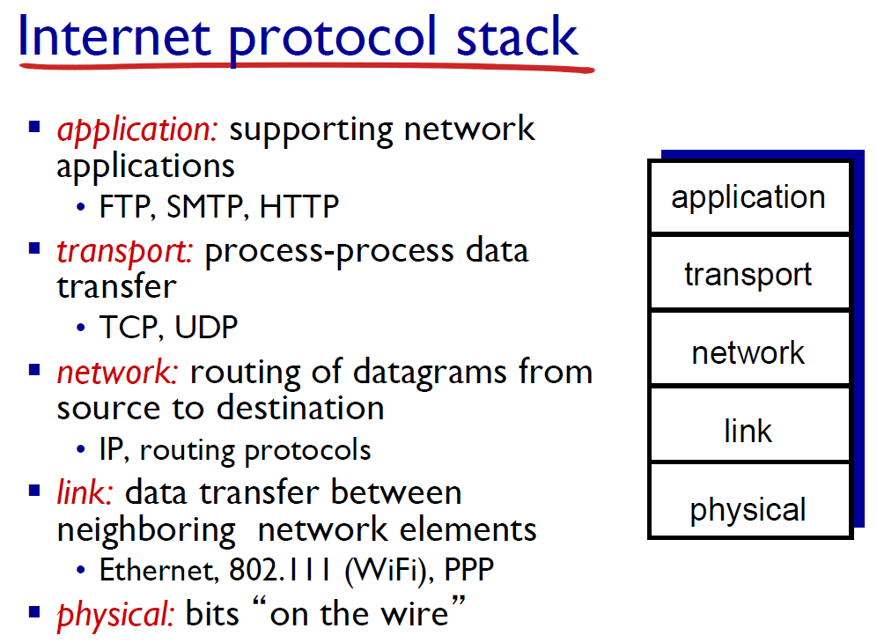
Recap
Notes:
As the semester progresses, we will be going down the stack.
(OSI – open systems interconnection)
There are actually 7 layers (session and presentation between application and transport in that order)

Slide 8
Recap
Circuit Switching
Setup/Teardown required
Resources are reserved
Service is guaranteed
Packet Switching
No setup/teardown required
Resources are not reserved
Service is best effort
Rtx from previous node
Rtx from source node
Not at all
Notes:
what does it mean to be best effort?

Slide 9
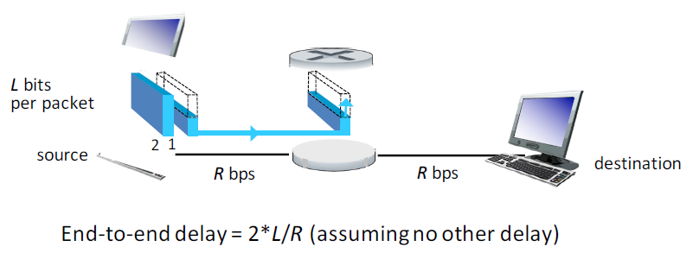
Recap
Internet is a packet switching network
Resources are not reserved
Data is segmented into smaller packets
Store & Forward
Entire packet must arrive at a router before it can be transmitted onto the next link

Slide 10
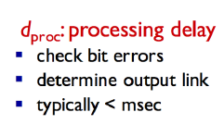
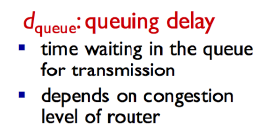
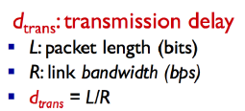
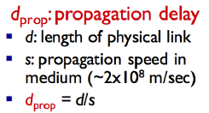
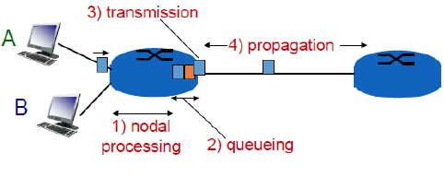
Recap
4 kinds of delay
Please ensure that the units are consistent (bytes vs bits)

Slide 11
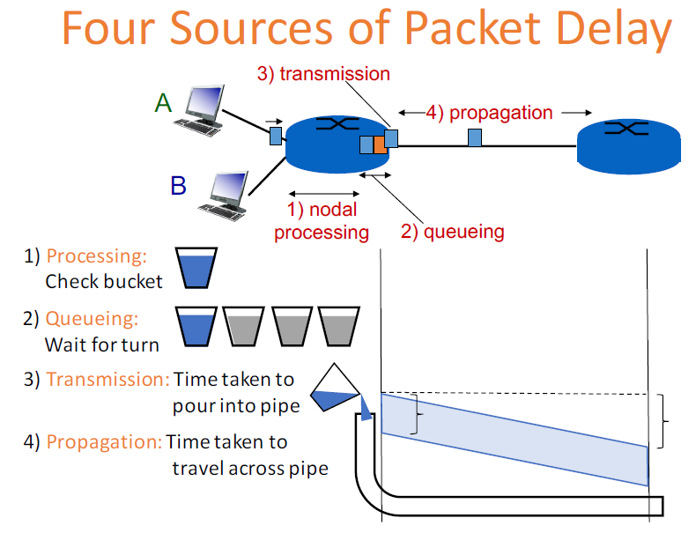
Recap
Notes:
Bandwidth is the capacity of the link
Throughput actual flow through the link

Slide 12
Tutorial Questions

Slide 13
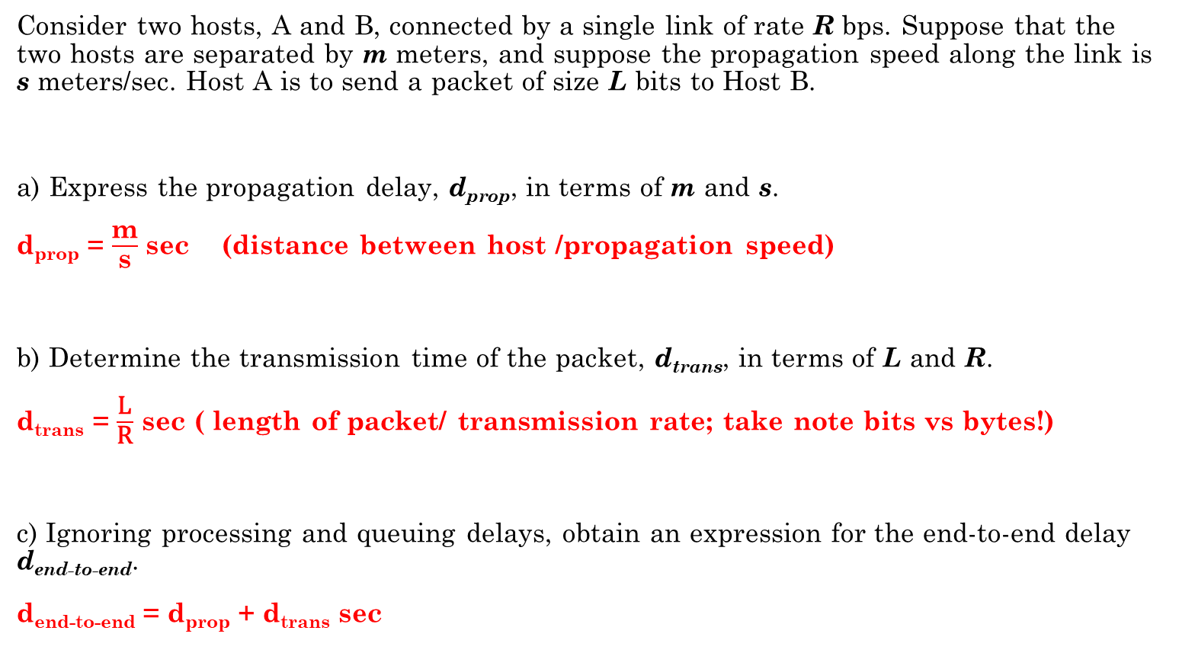
Question 1
Consider two hosts, A and B, connected by a single link of rate R bps. Suppose that the two hosts are separated by m meters, and suppose the propagation speed along the link is s meters/sec. Host A is to send a packet of size L bits to Host B.
a) Express the propagation delay, d_{prop}, in terms of m and s.
d_{prop} = $\frac{\text{m}}{\text{s}}$ sec (distance between host /propagation speed)
b) Determine the transmission time of the packet, d_{trans}, in terms of L and R.
d_{trans} = $\frac{\text{L}}{\text{R}}$ sec ( length of packet/ transmission rate; take note bits vs bytes!)
c) Ignoring processing and queuing delays, obtain an expression for the end-to-end delay d_{end-to-end}.
d_{end-to-end} = d_{prop} + d_{trans} sec

Slide 14
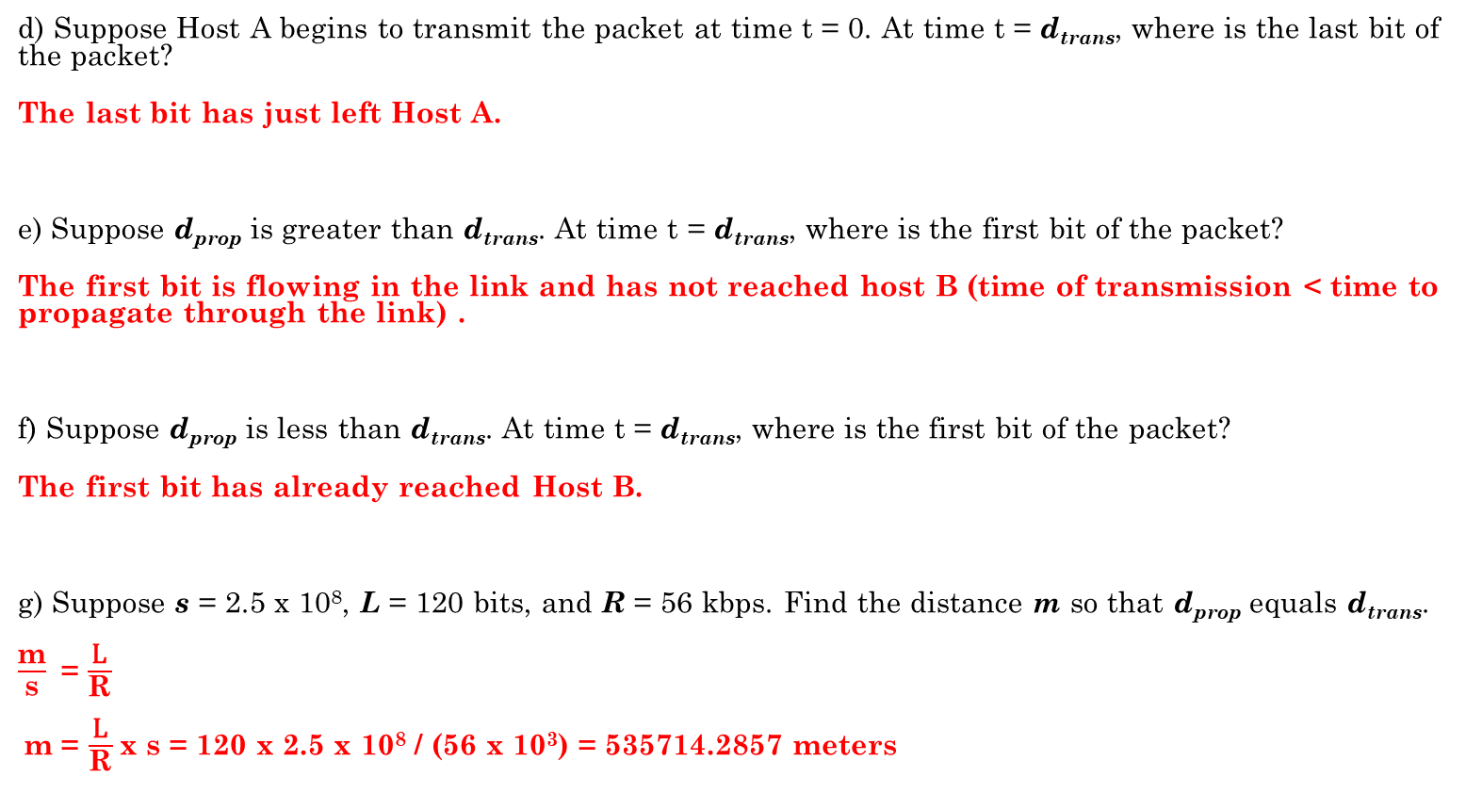
Question 1
d) Suppose Host A begins to transmit the packet at time t = 0. At time t = d_{trans}, where is the last bit of the packet?
The last bit has just left Host A.
e) Suppose d_{prop} is greater than d_{trans}. At time t = d_{trans}, where is the first bit of the packet?
The first bit is flowing in the link and has not reached host B (time of transmission < time to propagate through the link) .
f) Suppose d_{prop} is less than d_{trans}. At time t = d_{trans}, where is the first bit of the packet?
The first bit has already reached Host B.
g) Suppose s = 2.5 x 10⁸, L = 120 bits, and R = 56 kbps. Find the distance m so that d_{prop} equals d_{trans}.
$\frac{\text{m}}{\text{s}}$ = $\frac{\text{L}}{\text{R}}$
m = $\frac{\text{L}}{\text{R}}$x s = 120 x 2.5 x 10⁸ / (56 x 10³) = 535714.2857 meters

Slide 15
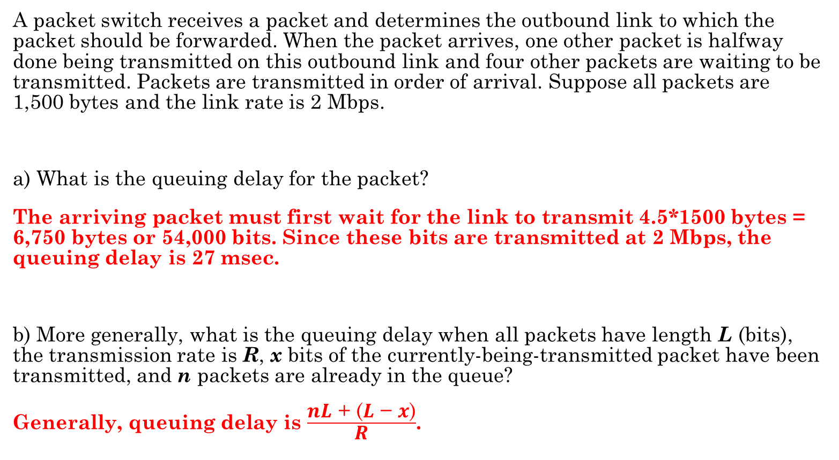
Question 2
A packet switch receives a packet and determines the outbound link to which the packet should be forwarded. When the packet arrives, one other packet is halfway done being transmitted on this outbound link and four other packets are waiting to be transmitted. Packets are transmitted in order of arrival. Suppose all packets are 1,500 bytes and the link rate is 2 Mbps.
a) What is the queuing delay for the packet?
The arriving packet must first wait for the link to transmit 4.5*1500 bytes = 6,750 bytes or 54,000 bits. Since these bits are transmitted at 2 Mbps, the queuing delay is 27 msec.
b) More generally, what is the queuing delay when all packets have length L (bits), the transmission rate is R, x bits of the currently-being-transmitted packet have been transmitted, and n packets are already in the queue?
Generally, queuing delay is $\frac{\text{nL}\text{ + (}\text{L}\text{ − }\text{x}\text{)}}{\text{R}}$.

Slide 16
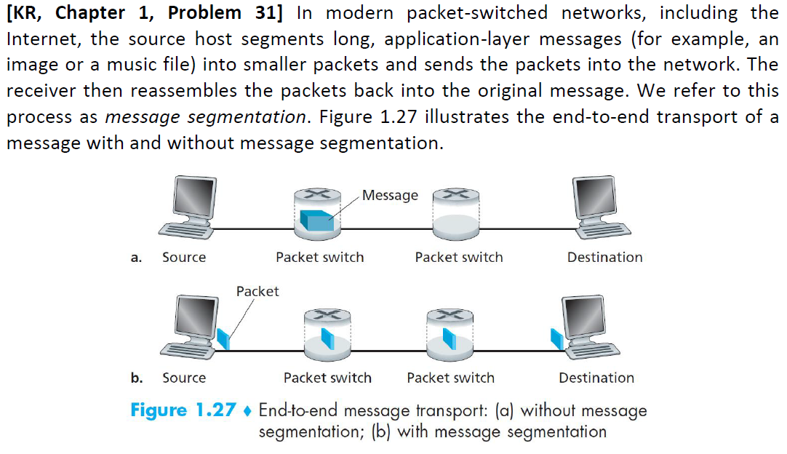
Question 3

Slide 17
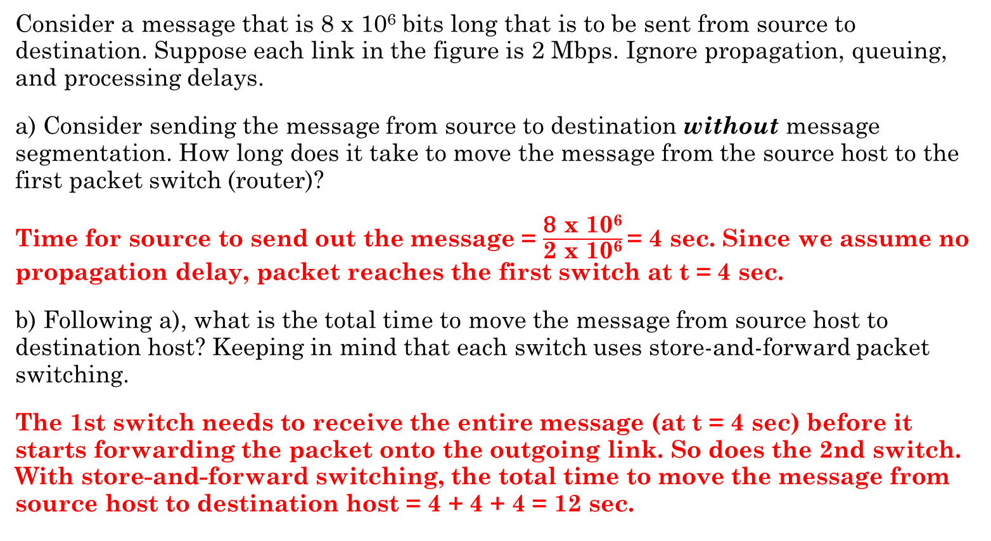
Question 3
Consider a message that is 8 x 10⁶ bits long that is to be sent from source to destination. Suppose each link in the figure is 2 Mbps. Ignore propagation, queuing, and processing delays.
a) Consider sending the message from source to destination without message segmentation. How long does it take to move the message from the source host to the first packet switch (router)?
Time for source to send out the message = $\frac{\text{8} \text{x}\text{ 106}}{\text{2 }\text{x}\text{ 106}}$= 4 sec. Since we assume no propagation delay, packet reaches the first switch at t = 4 sec.
b) Following a), what is the total time to move the message from source host to destination host? Keeping in mind that each switch uses store-and-forward packet switching.
The 1st switch needs to receive the entire message (at t = 4 sec) before it starts forwarding the packet onto the outgoing link. So does the 2nd switch. With store-and-forward switching, the total time to move the message from source host to destination host = 4 + 4 + 4 = 12 sec.

Slide 18
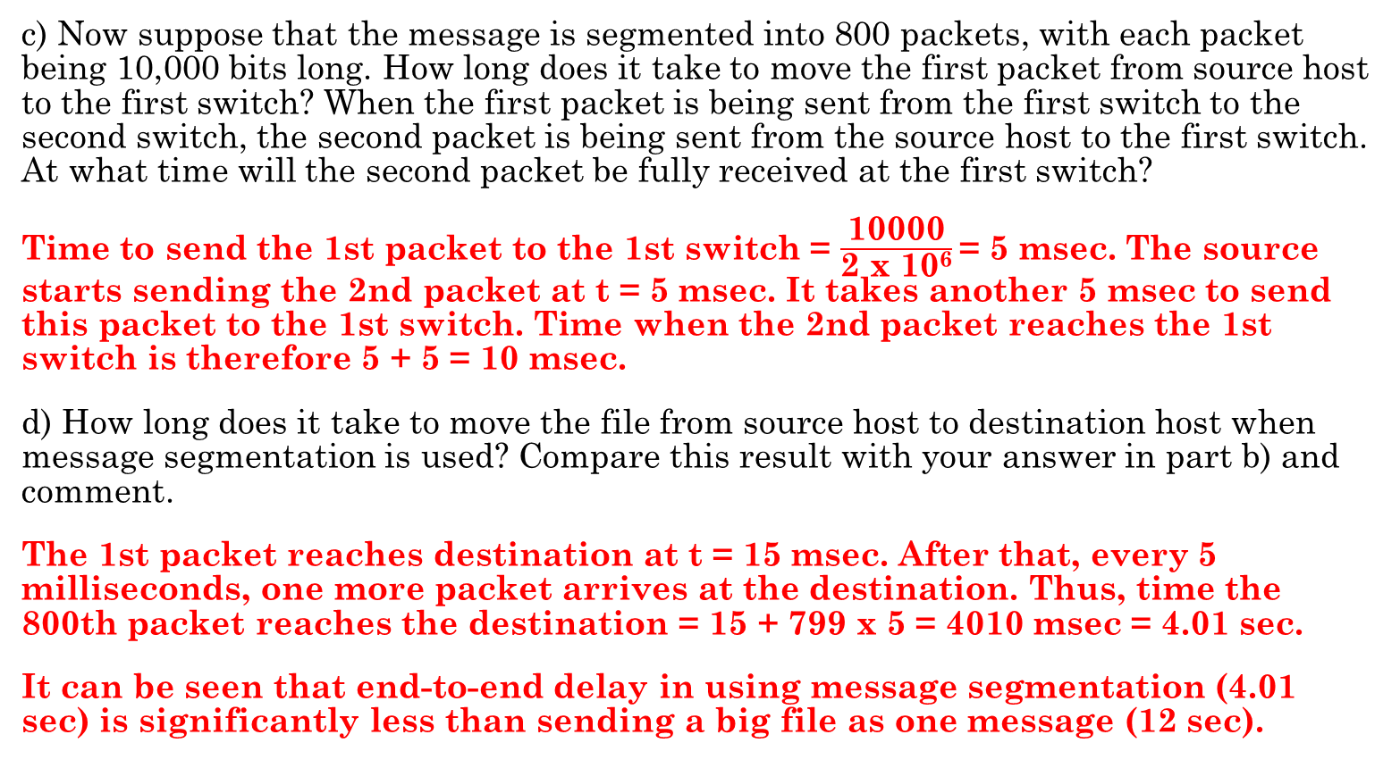
Question 3
c) Now suppose that the message is segmented into 800 packets, with each packet being 10,000 bits long. How long does it take to move the first packet from source host to the first switch? When the first packet is being sent from the first switch to the second switch, the second packet is being sent from the source host to the first switch. At what time will the second packet be fully received at the first switch?
Time to send the 1st packet to the 1st switch = $\frac{\text{10000}}{\text{2 }\text{x}\text{ 106}}$= 5 msec. The source starts sending the 2nd packet at t = 5 msec. It takes another 5 msec to send this packet to the 1st switch. Time when the 2nd packet reaches the 1st switch is therefore 5 + 5 = 10 msec.
d) How long does it take to move the file from source host to destination host when message segmentation is used? Compare this result with your answer in part b) and comment.
The 1st packet reaches destination at t = 15 msec. After that, every 5 milliseconds, one more packet arrives at the destination. Thus, time the 800th packet reaches the destination = 15 + 799 x 5 = 4010 msec = 4.01 sec.
It can be seen that end-to-end delay in using message segmentation (4.01 sec) is significantly less than sending a big file as one message (12 sec).

Slide 19
Question 3
e) In addition to reducing delay, what are reasons to use message segmentation?
(i). Without message segmentation, if bit errors are not tolerated and there is a single bit error, the whole message has to be retransmitted (rather than a single packet).
(ii). Without message segmentation, huge packets (containing HD videos, for example) are sent into the network. Routers have to accommodate these huge packets. Smaller packets have to queue behind enormous packets and suffer unfair delays.
f) Discuss the drawbacks of message segmentation.
(i). Packets have to be put in sequence at the destination (network may re-order packets).
(ii). Message segmentation results in many smaller packets. Each packet needs to carry packet header of size tens of bytes (e.g., to specific destination address and port number). This is the header overhead of each packet to be discussed in later lectures.

Slide 20
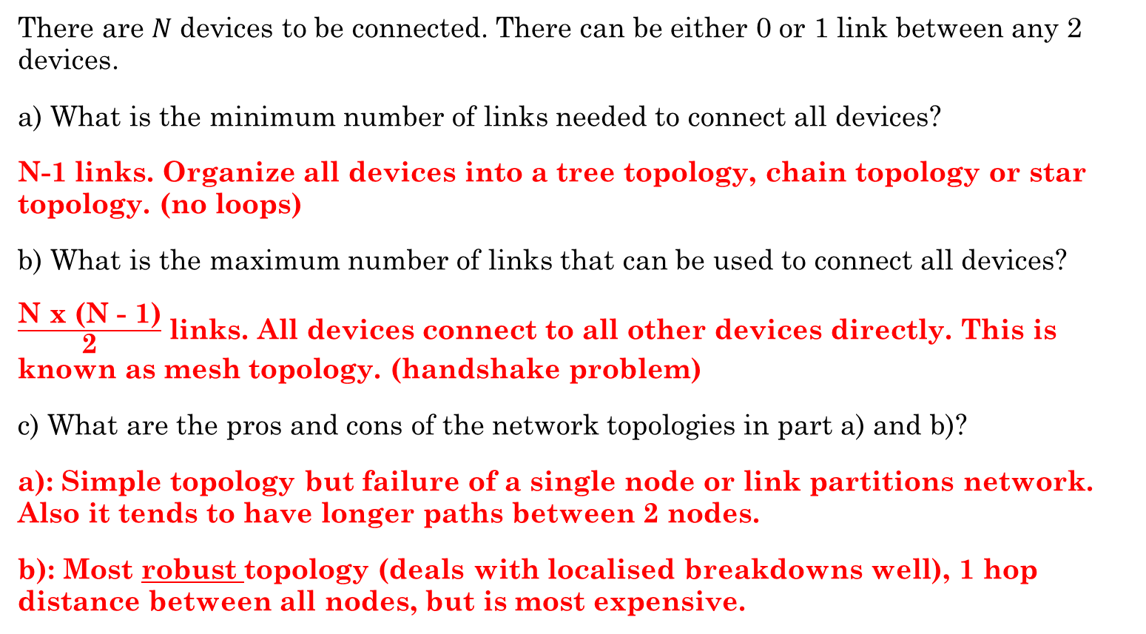
Question 4
There are 𝑁 devices to be connected. There can be either 0 or 1 link between any 2 devices.
a) What is the minimum number of links needed to connect all devices?
N-1 links. Organize all devices into a tree topology, chain topology or star topology. (no loops)
b) What is the maximum number of links that can be used to connect all devices?
$\frac{\text{N} \text{x}\text{ (}\text{N}\text{ − 1)}}{\text{2}}$ links. All devices connect to all other devices directly. This is known as mesh topology. (handshake problem)
c) What are the pros and cons of the network topologies in part a) and b)?
a): Simple topology but failure of a single node or link partitions network. Also it tends to have longer paths between 2 nodes.
b): Most robust topology (deals with localised breakdowns well), 1 hop distance between all nodes, but is most expensive.

Slide 21
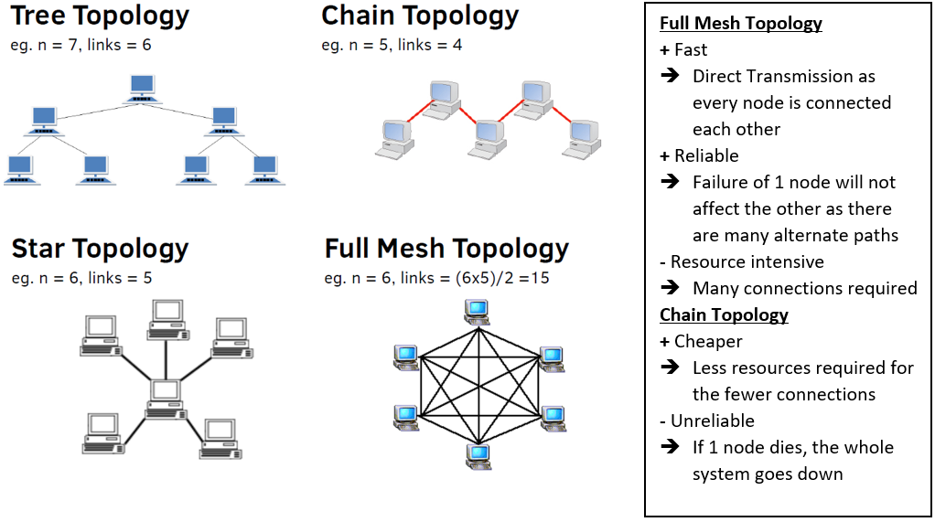
Network topologies (extra)

Slide 22
Summary
Internet Architecture
Circuit switching vs Packet switching
4 kinds of delays
(Nodal) Processing
Queueing
Transmission
Propagation
Message segmentation
Network topologies

Slide 23
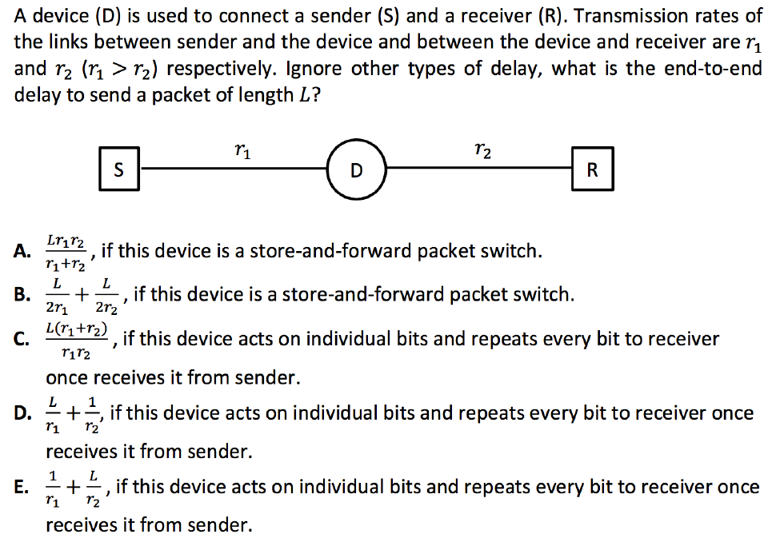
Extra Questions

Slide 24
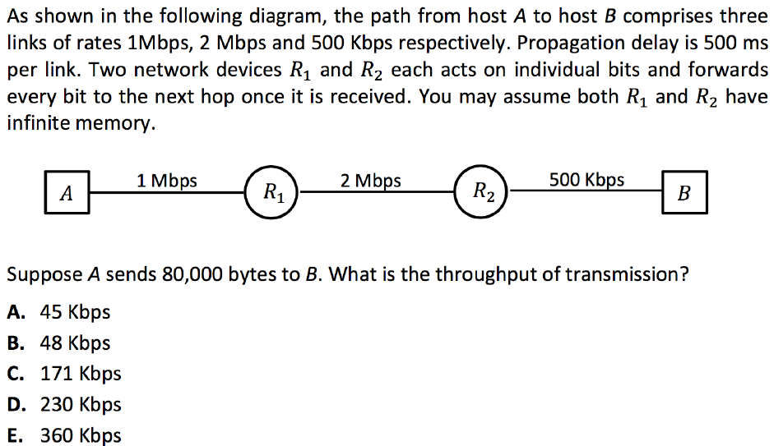
Extra Questions

Slide 25
Thank you!
Answers:
E, D

